Slide 1
Applications: Radar Principles and Signal Processing
Dr Carmine Clemente
carmine.clemente@strath.ac.uk
1

Slide 2
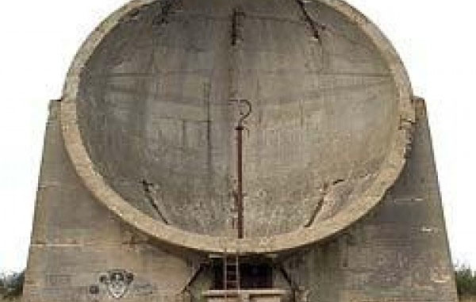
History- Before Radars
English Acoustic Locator

Slide 3
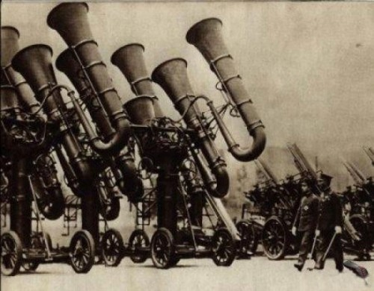
History- Before Radars
Japanese Acoustic Locator

Slide 4
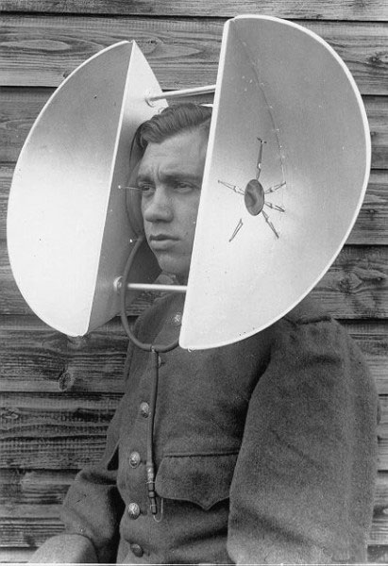
History- Before Radars
Professor Meyer’s Locator

Slide 5
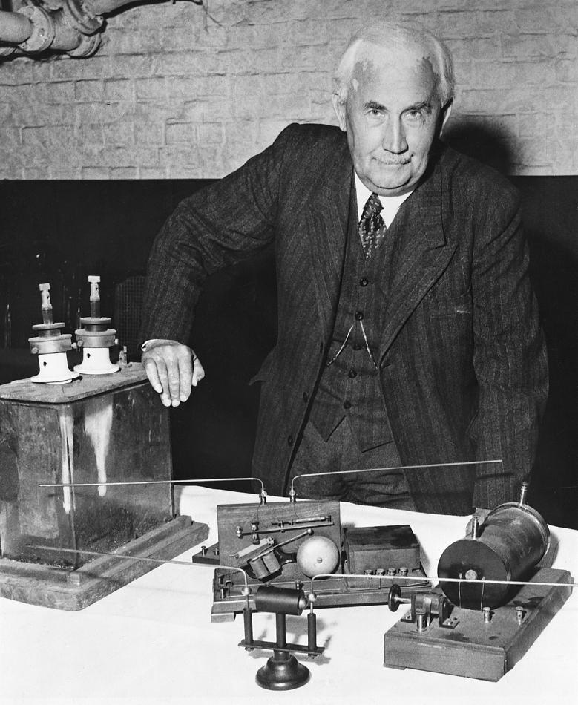
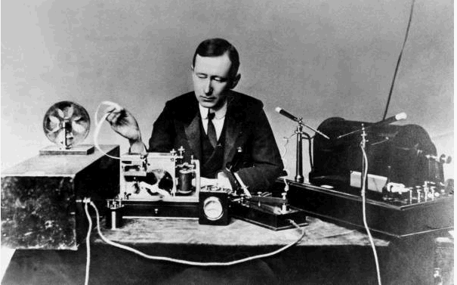
History
Hülsmeyer - Germany
Radar was first patented and demonstrated in 1904 by the German engineer Christian Hülsmeyer.
His telemobilskop used a special spark-gap transmitter operating on a 40–50-cm wavelength and a separate receiver that rang a bell when detecting ships up to 5 km from the receiver.
The first fully documented demonstration of the telemobilskop was in Cologne, in May 1904, with both the transmitter and receiver located on a platform under the Rhine Bridge (a chain suspension bridge destroyed during World War II) in a monostatic configuration to detect ships on the Rhine River.
Taylor and Young- USA
This radar effect was rediscovered by A. H. Taylor and L. C. Young in 1922 when they were
carrying out 60 MHz propagation at the U. S. Navy Aircraft Laboratory, Anacostia,
DC. They first detected bistatic reflections from buildings, trees, and other stationary objects and
then a wooden steamer traveling down the Potomac River, which cut the beam in what is now
known as the forward-scatter mode
Marconi -Italy
In 1922 Guglielmo Marconi at a Institute of Electrical Engineers and at the Institute of Radio Engineers in New York stated that there was the possibility of perceiving the presence of a ship by means of an ultrashort wave beam even at a distance of miles.
His work promoted Ugo Tiberio’s interest who developed the first version of the radar equation.

Slide 6
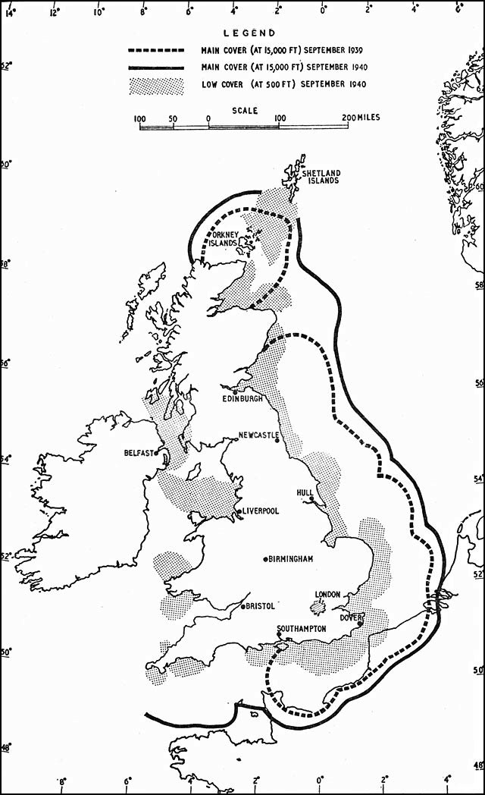
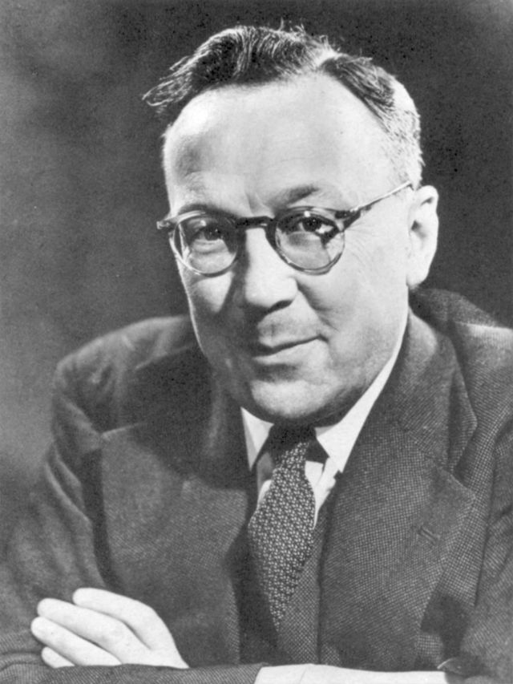
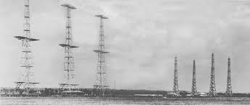
History
Watson Watt- UK
In June 17, 1935, radio-based detection and ranging was first demonstrated in Great Britain. Watson Watt, Wilkins, and Bowen are generally credited with initiating what would later be called radar.
In 1935, Watson Watt had been asked by the UK Air Ministry to investigate the feasibility of Electromagnetic “death rays” to disable aircraft. He concluded, in an elegantly-reasoned piece, that it would not be feasible, but that detection of aircraft using radio waves should be possible. The same year he demonstrated detection of
aircraft at a range of up to 8 miles in what has become known as “the Daventry experiment”.
Chain Home
The new invention was immediately exploited during WWII to defend British borders from german bombers. A network of radar systems was able to cover all the sensitive borders and to provide enough notice to british air force in order to allow better defence resource allocation.
This system was a tactical advantage that postponed indefinitely german invasion of Great Britain.

Slide 7
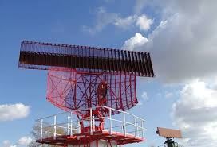
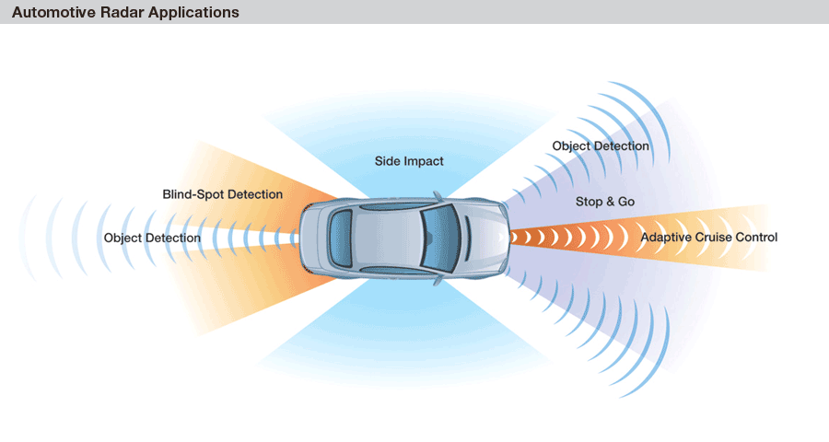
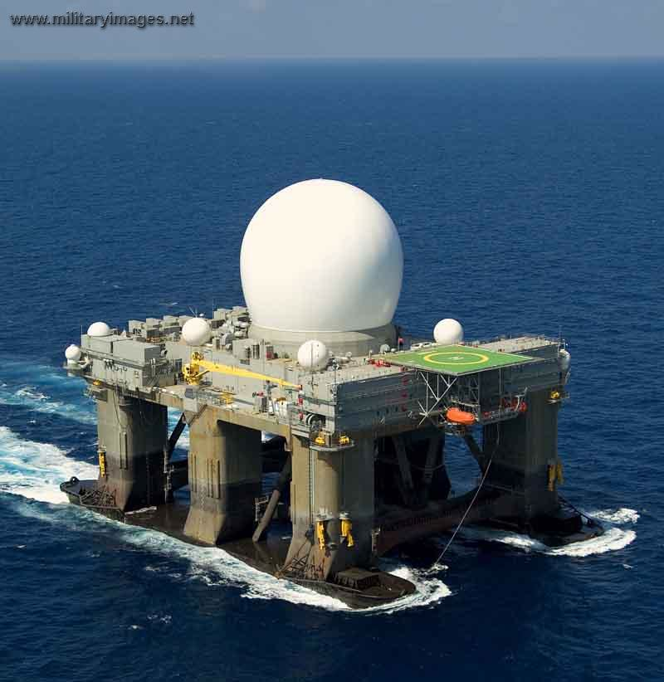
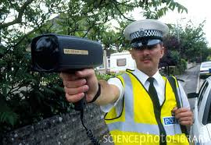
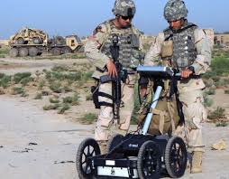
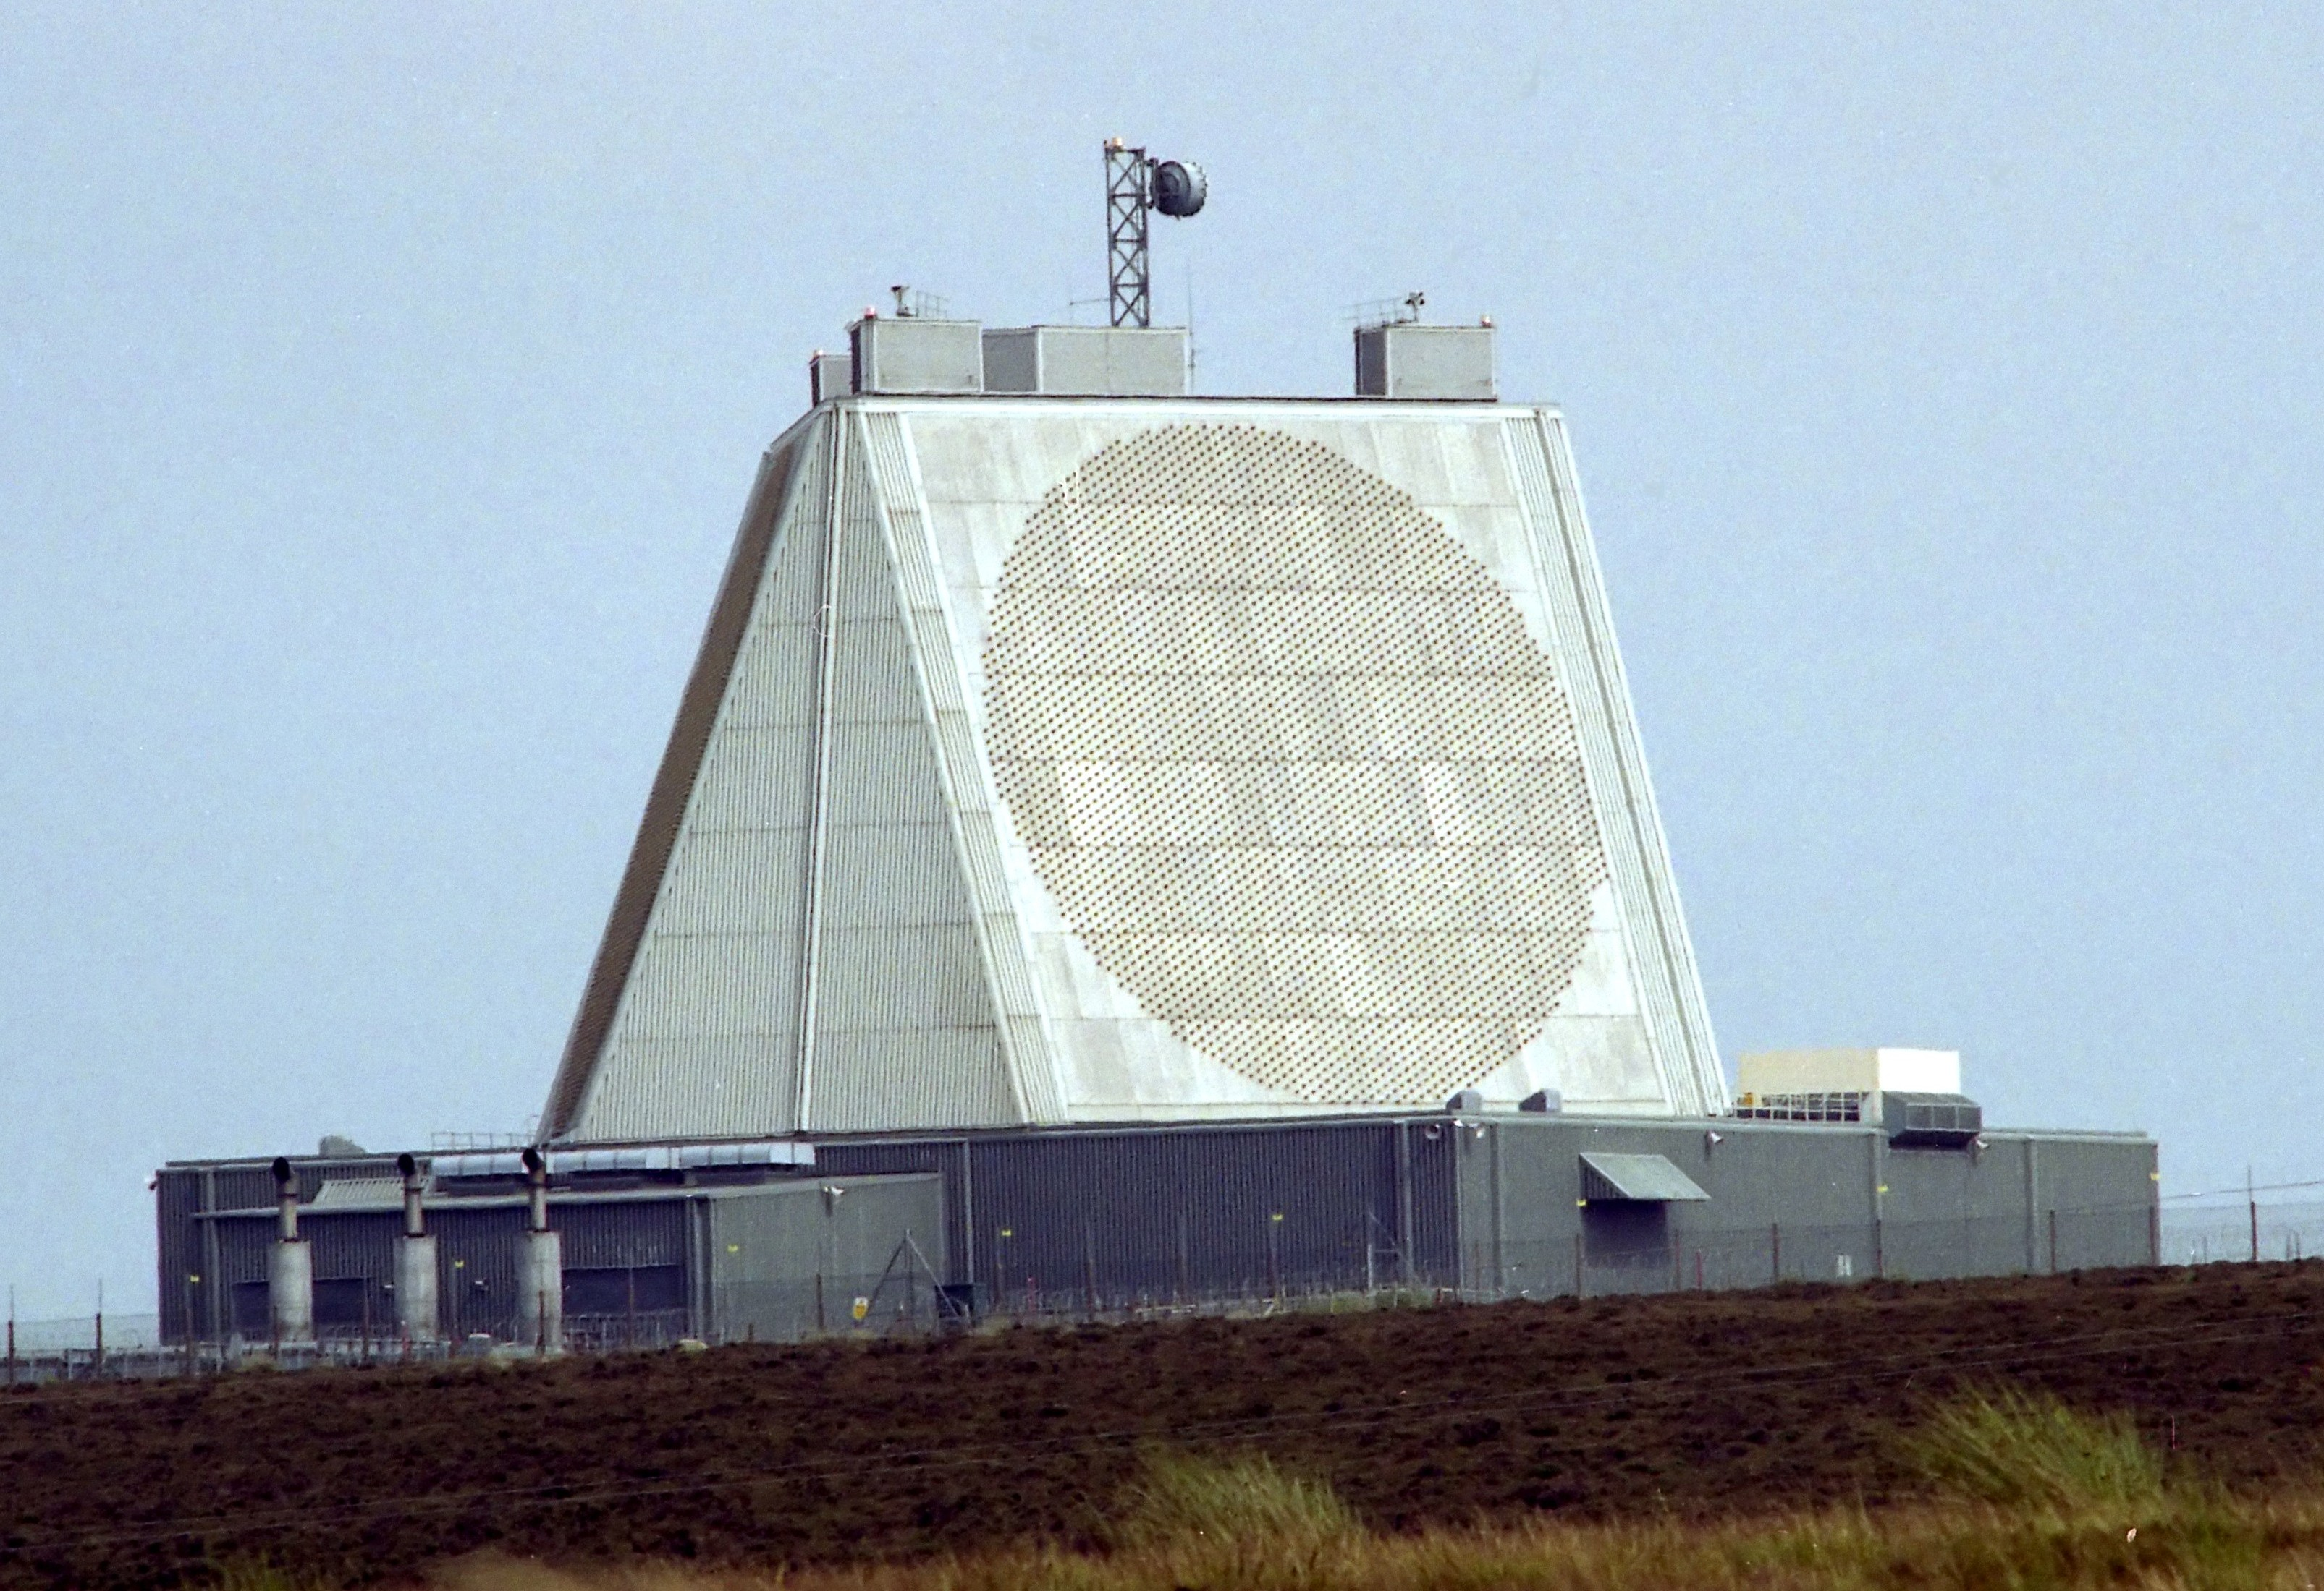
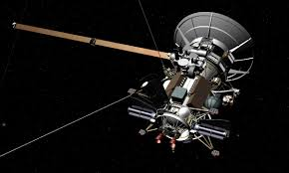
Examples

Slide 8
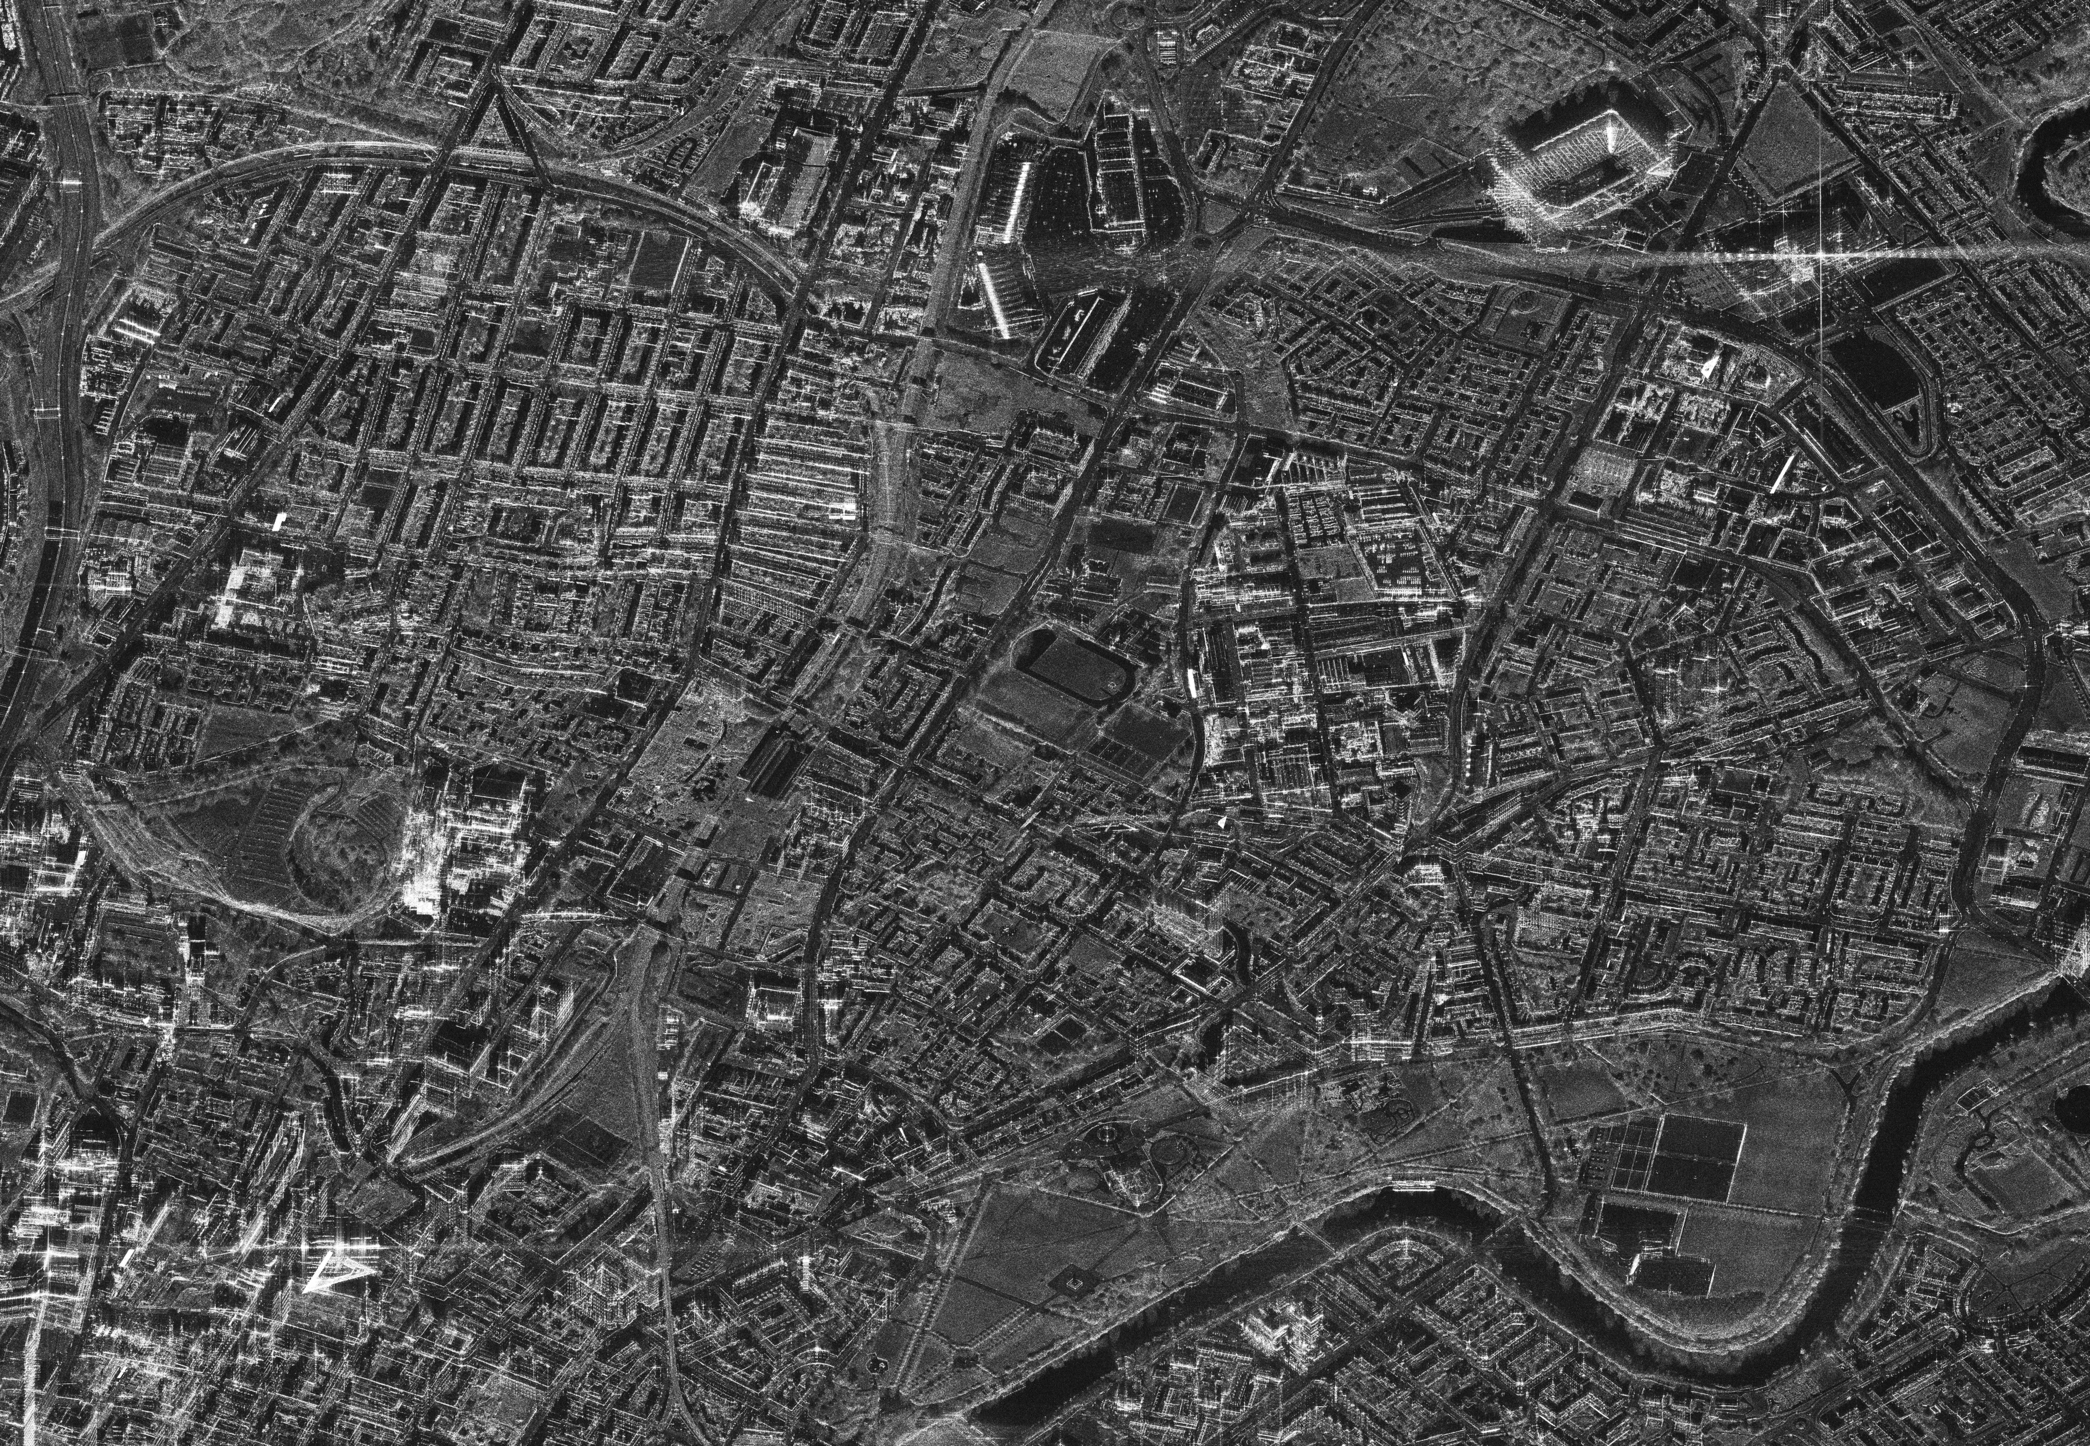

Slide 9
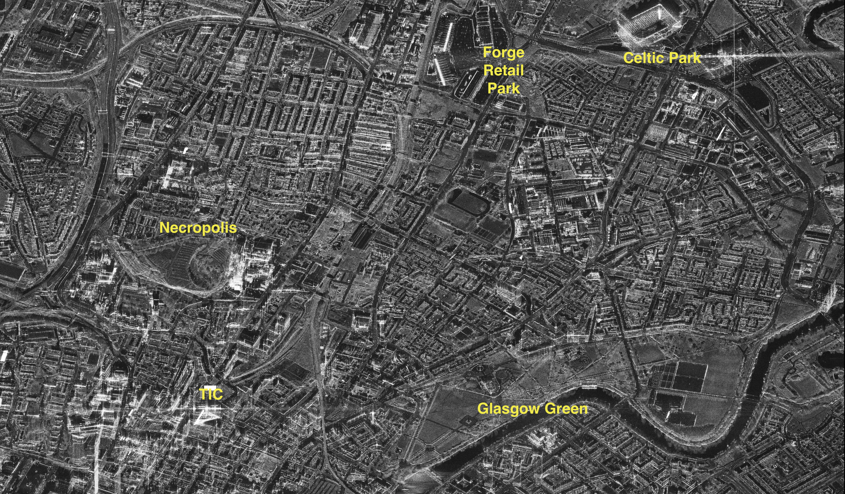

Slide 10
Working Principle
RAdio Detection And Ranging
Radar is an electromagnetic system for the detection and location of reflecting objects such as aircraft, ships, spacecraft, vehicles, people and the natural environment;
Radar can perform its function at long or short distances and under conditions impervious to optical and infra-red sensors. It can operate in darkness, haze, fog, rain, and snow. Its ability to measure distance with high accuracy and in all weather is one of its most important attributes;
The range of radars can exceed hundreds of miles and they can be placed on mobile platforms greatly increasing their effectiveness.

Slide 11
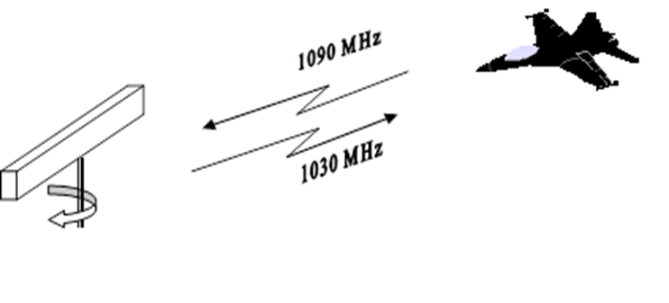
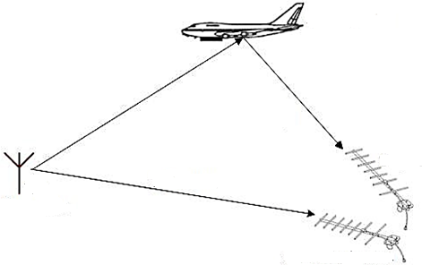
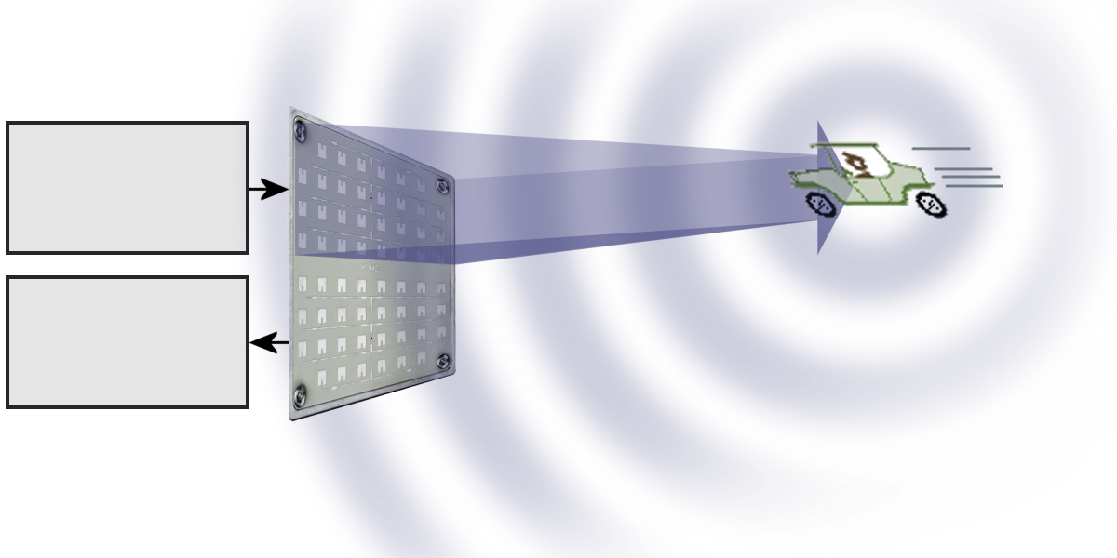

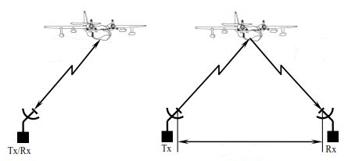
Radar Categorisation
1090Mhz
Operation:
Primary: Target monitoring;
Secondary: Transponder on the target (Fig.);
Illuminator:
Active: Uses its transmitter to illuminate the target;
Passive: Exploit illuminators of opportunity (Fig.);
Transmission rate:
Pulsed: Emit separated pulses;
Continuous Wave (CW): Constant transmission (Fig.);
Geometry:
Monostatic: Transmitter and receiver in the same location (Fig. Left);
Bistatic: Transmitter and receiver in separate locations (Fig. Right).
1030Mhz
Interrogator
Transponder
Illuminator
Radar
Ref. Channel
T
R
Monostatic
Bistatic

Slide 12
Operating Principles
The simplest radar operation can be divided into 4 steps:
The radar is transmitting an EM pulse;
The radar switches to listening mode;
The pulse is reflected by a target;
The radar receives the echoes from the transmitted pulse.
Using various properties of the received echo, the radar can extract parameters such as the range and velocity of the target
Transmitted pulse
Transmitter
Duplexer
Receiver
Reflected pulse

Slide 13
Operating Principles
The simplest radar operation can be divided into 4 steps:
The radar is transmitting an EM pulse;
The radar switches to listening mode;
The pulse is reflected by a target;
The radar receives the echoes from the transmitted pulse.
Using various properties of the received echo, the radar can extract parameters such as the range and velocity of the target
Transmitted pulse
Transmitter
Duplexer
Receiver
Reflected pulse

Slide 14
Operating Principles
The simplest radar operation can be divided into 4 steps:
The radar is transmitting an EM pulse;
The radar switches to listening mode;
The pulse is reflected by a target;
The radar receives the echoes from the transmitted pulse.
Using various properties of the received echo, the radar can extract parameters such as the range and velocity of the target
Transmitted pulse
Transmitter
Duplexer
Receiver
Reflected pulse

Slide 15
Operating Principles
The simplest radar operation can be divided into 4 steps:
The radar is transmitting an EM pulse;
The radar switches to listening mode;
The pulse is reflected by a target;
The radar receives the echoes from the transmitted pulse.
Using various properties of the received echo, the radar can extract parameters such as the range and velocity of the target
Transmitted pulse
Transmitter
Duplexer
Receiver
Reflected pulse

Slide 16
Operating Principles
The simplest radar operation can be divided into 4 steps:
The radar is transmitting an EM pulse;
The radar switches to listening mode;
The pulse is reflected by a target;
The radar receives the echoes from the transmitted pulse.
Using various properties of the received echo, the radar can extract parameters such as the range and velocity of the target
Transmitted pulse
Transmitter
Duplexer
Receiver
Reflected pulse

Slide 17
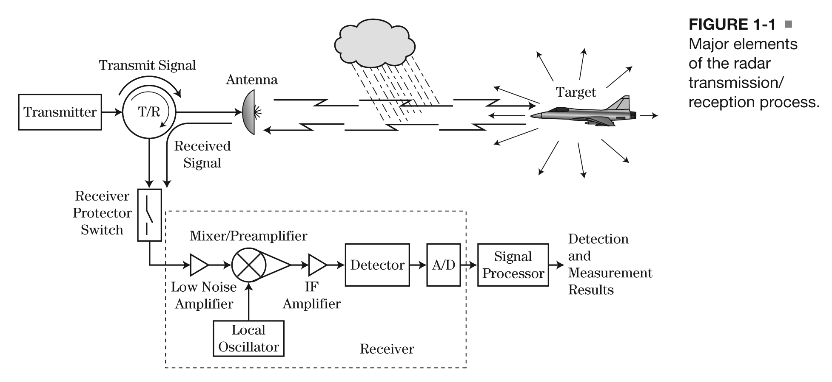
Radar Basic Components
From: Richards, Mark A.; Scheer, James A.; Holm, William A. (ed.): 'Principles of Modern Radar: Basic principles' (Radar, Sonar and Navigation, 2010)

Slide 18
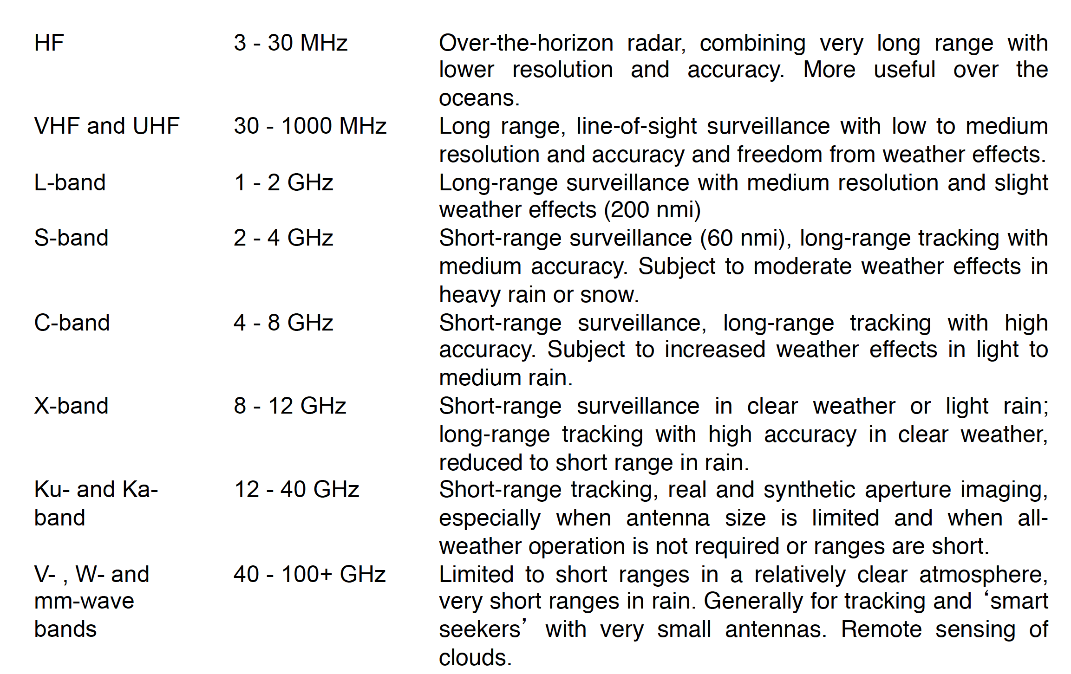
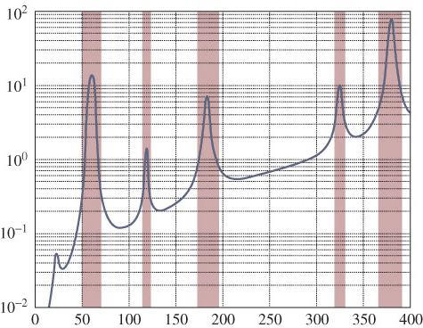
Radar Bands
Atmospheric loss [dB/Km]
Frequency [GHz]
Low frequencies are preferable for long-range radars
From: Richards, Mark A.; Scheer, James A.; Holm, William A. (ed.): 'Principles of Modern Radar: Basic principles' (Radar, Sonar and Navigation, 2010)

Slide 19
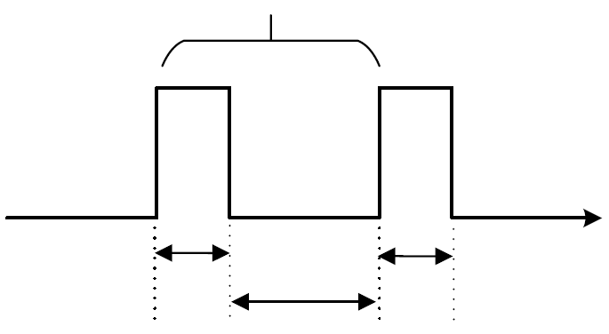
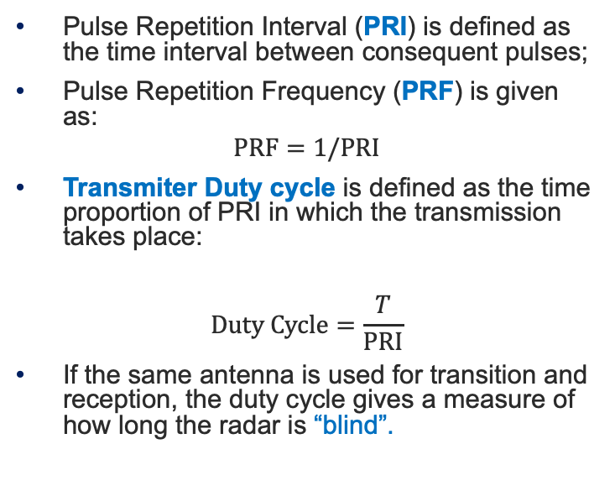
Pulse repetition Interval
Pulse Repetition Interval (PRI) is defined as the time interval between consequent pulses;
Pulse Repetition Frequency (PRF) is given as:
$$PRF=1/PRI$$
Transmiter Duty cycle is defined as the time proportion of PRI in which the transmission takes place:
$$Duty Cycle=\frac{T}{PRI}$$
If the same antenna is used for transition and reception, the duty cycle gives a measure of how long the radar is “blind”.
PRI
Transmission
Time
Reception

Slide 20
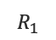
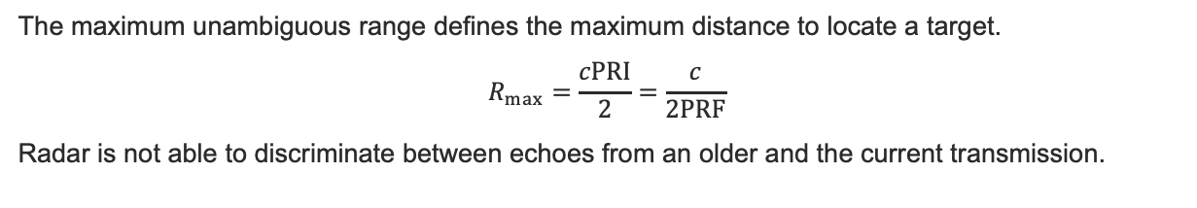
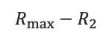
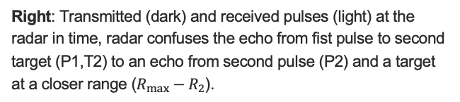
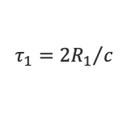
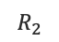
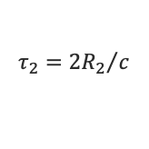
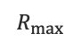
Maximum Unambiguous Range
The maximum unambiguous range defines the maximum distance to locate a target.
$$R_{max}=\frac{cPRI}{2}=\frac{c}{2PRF}$$
Radar is not able to discriminate between echoes from an older and the current transmission.
$$R_{1}$$
$$τ_{1}={2R_{1}}/c$$
$$R_{2}$$
$$τ_{2}={2R_{2}}/c$$
$$R_{max}$$
PRI
T1
T2
P1
P1,T1
P2
P1,T2
$$R_{max}−R_{2}$$
Range
Time
Right: Transmitted (dark) and received pulses (light) at the radar in time, radar confuses the echo from fist pulse to second target (P1,T2) to an echo from second pulse (P2) and a target at a closer range ($R_{max}−R_{2}$).
Left: Radar and two real targets (dark), one in (T1) and one out (T2) of unambiguous range, second target (T2) appears in closer range (light).

Slide 21
Maximum Unambiguous Range
The maximum unambiguous range defines the maximum distance to locate a target.
$$R_{max}=\frac{cPRI}{2}=\frac{c}{2PRF}$$
Radar is not able to discriminate between echoes from an older and the current transmission.
$$R_{1}$$
$$τ_{1}={2R_{1}}/c$$
$$R_{2}$$
$$τ_{2}={2R_{2}}/c$$
$$R_{max}$$
PRI
T1
T2
P2,T1
P1
P1,T1
P2
P1,T2
$$R_{max}−R_{2}$$
Range
Time
Right: Transmitted (dark) and received pulses (light) at the radar in time, radar confuses the echo from fist pulse to second target (P1,T2) to an echo from second pulse (P2) and a target at a closer range ($R_{max}−R_{2}$).
Left: Radar and two real targets (dark), one in (T1) and one out (T2) of unambiguous range, second target (T2) appears in closer range (light).

Slide 22
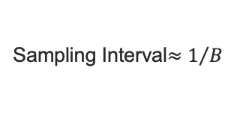
Data matrix
Radar returns from each PRI are stored in memory for further processing;
Fast Time refers to the different time slots composing a PRI, sampling rate dependent;
Slow Time updates every PRI;
Sampling Interval$≈1/B$
Slow Time
Example of two targets, one staying in the same resolution bin (blue) and one moving in different resolution bins (green);
Top: Data matrix for 10 time resolution bins and 4 PRI;
Bottom: Radar returns in time;
PRI
Fast Time
PRI
Time

Slide 23
Data matrix
Radar returns from each PRI are stored in memory for further processing;
Fast Time refers to the different time slots composing a PRI, sampling rate dependent;
Slow Time updates every PRI;
Sampling Interval$≈1/B$
Slow Time
Example of two targets, one staying in the same resolution bin (blue) and one moving in different resolution bins (green);
Top: Data matrix for 10 time resolution bins and 4 PRI;
Bottom: Radar returns in time;
PRI
Fast Time
PRI
Time

Slide 24
Data matrix
Radar returns from each PRI are stored in memory for further processing;
Fast Time refers to the different time slots composing a PRI, sampling rate dependent;
Slow Time updates every PRI;
Sampling Interval$≈1/B$
Slow Time
Example of two targets, one staying in the same resolution bin (blue) and one moving in different resolution bins (green);
Top: Data matrix for 10 time resolution bins and 4 PRI;
Bottom: Radar returns in time;
PRI
Fast Time
PRI
Time

Slide 25
Data matrix
Radar returns from each PRI are stored in memory for further processing;
Fast Time refers to the different time slots composing a PRI, sampling rate dependent;
Slow Time updates every PRI;
Sampling Interval$≈1/B$
Slow Time
Example of two targets, one staying in the same resolution bin (blue) and one moving in different resolution bins (green);
Top: Data matrix for 10 time resolution bins and 4 PRI;
Bottom: Radar returns in time;
PRI
Fast Time
PRI
Time

Slide 26
Data matrix
Radar returns from each PRI are stored in memory for further processing;
Fast Time refers to the different time slots composing a PRI, sampling rate dependent;
Slow Time updates every PRI;
Sampling Interval$≈1/B$
Slow Time
Example of two targets, one staying in the same resolution bin (blue) and one moving in different resolution bins (green);
Top: Data matrix for 10 time resolution bins and 4 PRI;
Bottom: Radar returns in time;
PRI
Fast Time
PRI
Time

Slide 27
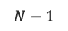
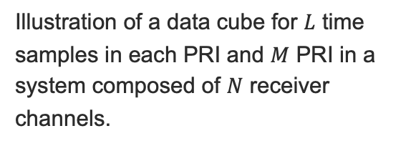
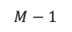
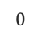
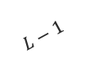

Data Cube
Data Cube is an extension to Data Matrix including spatial sampling;
In cases that the radar uses multiple receiving channels, the data matrices from each receiver are stacked to form a data cube;
Illustration of a data cube for $L$ time samples in each PRI and $M$ PRI in a system composed of $N$ receiver channels.
$$N−1$$
$$L−1$$
Receiver Channel
Fast Time
$$0$$
Slow Time
$$0$$
$$M−1$$

Slide 28
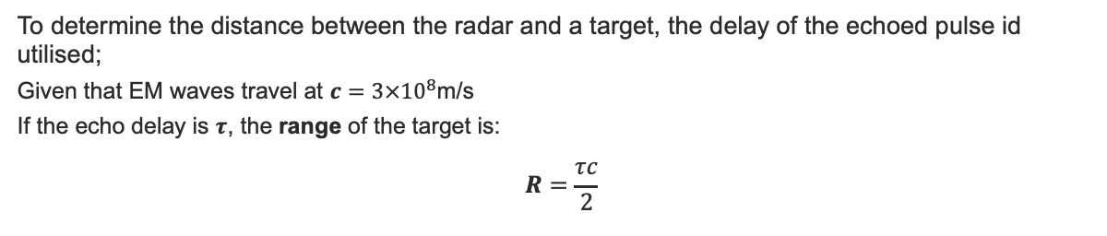
Distance Determination
To determine the distance between the radar and a target, the delay of the echoed pulse id utilised;
Given that EM waves travel at $c=3×{10}^{8}$m/s
If the echo delay is $τ$, the range of the target is:
$$R=\frac{τc}{2}$$
Emmision of a pulse at $t=0;$
Time
Pulse reaches the target at $t=τ/2$;
A part of the pulse is reflected to the radar;
The echo from the target is received at $t=τ$.
Range

Slide 29
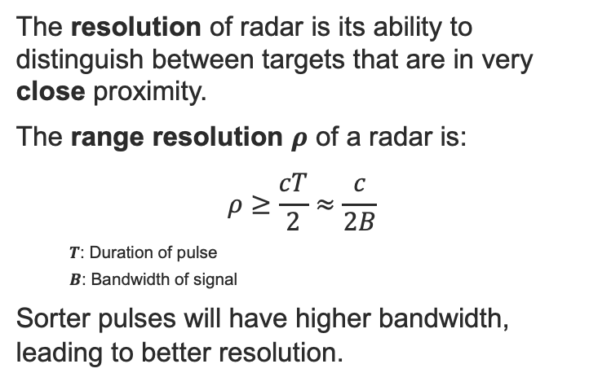
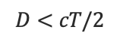
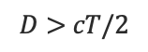
Range Resolution
$$D>cT/2$$
The resolution of radar is its ability to distinguish between targets that are in very close proximity.
The range resolution $ρ$ of a radar is:
$$ρ≥\frac{cT}{2}≈\frac{c}{2B}$$
$T$: Duration of pulse
$B$: Bandwidth of signal
Sorter pulses will have higher bandwidth, leading to better resolution.
Time
(A)
Range
$$D<cT/2$$
Time
(B)
Range resolution issue between targets in close proximity with each other (A) Two resolved targets; (B) One resolved target. Red part denoted the overlap between the two echoes
Range

Slide 30
Working Principle
RAdio Detection And Ranging
Radar is an electromagnetic system for the detection and location of reflecting objects such as aircraft, ships, spacecraft, vehicles, people and the natural environment;
Radar can perform its function at long or short distances and under conditions impervious to optical and infra-red sensors. It can operate in darkness, haze, fog, rain, and snow. Its ability to measure distance with high accuracy and in all weather is one of its most important attributes;
The range of radars can exceed hundreds of miles and they can be placed on mobile platforms greatly increasing their effectiveness.

Slide 31
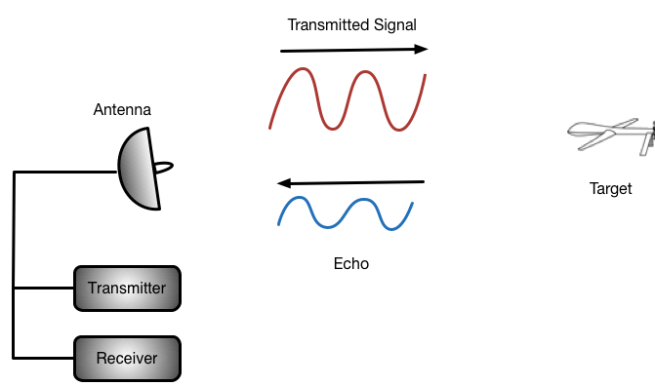
Working Principle
The simplest radar system transmits a pulse of high energy and listens for the echo of that pulse;
Given that EM energy travels at c = 3 x 10^8 m/s, the time it takes for a pulse to travel to a target and the echo to travel back will tell us the range.

Slide 32
Radar Basics

Slide 33
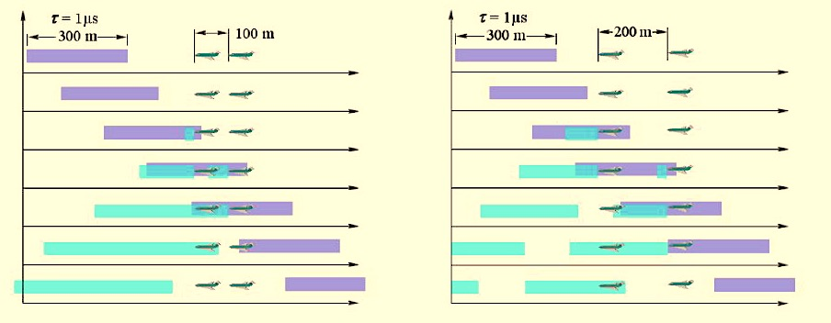
Radar Range Resolution
Purple – travelling towards the target;
Cyan – reflected from the target (travelling towards the radar):
Scenario 1
Scenario 2
Shorter pulses have higher bandwidth, but not enough energy to reach distant targets.

Slide 34
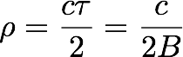
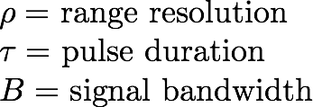
Radar Range Resolution
Radar Range Resolution depends on the Bandwidth of the transmitted signal.
Shorter pulses have higher bandwidth, but not enough energy to reach distant targets.

Slide 35
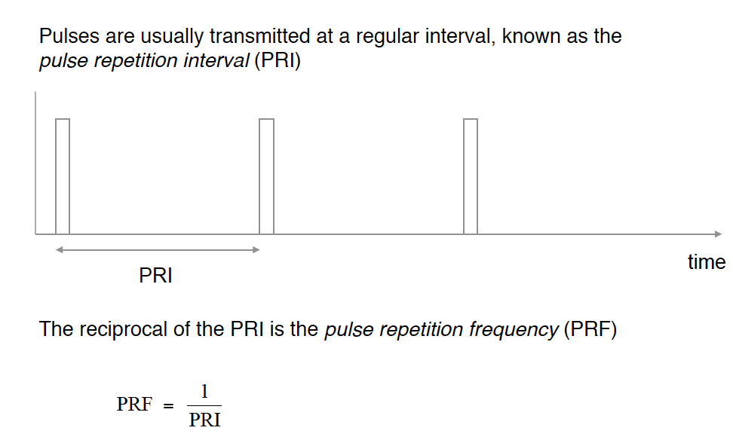
PRI and PRF

Slide 36
Maximum Unambiguous Range
Associated with a PRF is the maximum unambiguous range, defining the maximum unambiguous distance to locate a target.
Echo of first pulse from target 1
Echo of first pulse from target 2
1st pulse
2nd pulse
PRI
Time
The maximum unambiguous range is therefore

Slide 37
Data Matrix
Every PRI a column of the Data Matrix is Populated
Fast time samples are equivalent to target ranges
Slow time represent the response of the environment in different PRI
Fast Time
Slow Time

Slide 38
Data Matrix
Fast Time
Slow Time
SlowTime
Fast Time

Slide 39
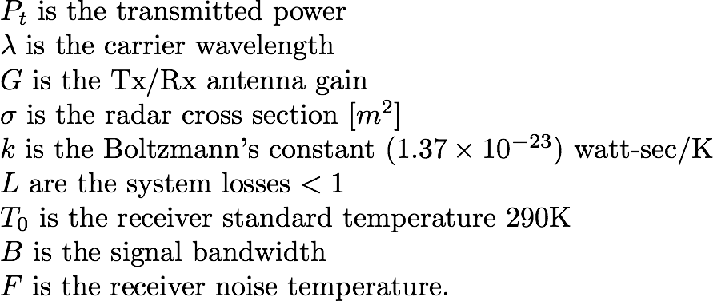
Radar Equation
4

Slide 40
Radar Equation
The radar equation puts together the different elements of the measurement systems in order to identify design needs
Due to the random nature of the noise, a radar detection problem is generally treated and characterized statistically;
A detector has a statistical characterization (False Alarm Probability vs Detection Probability) that is influenced by the SNR.
Thus a given SNR can provide the desired detection performances… but at what distance???
4
or
We can also know the smallest detectable target

Slide 41


Worked Example – Range Resolution
We want to be able to resolve two targets distant 1 km from each other, how long should the pulse be?
The required range resolution has to be:
Meaning that
The pulse will have a bandwidth of:

Slide 42

Worked Example – Data Matrix Size
A radar transmits a pulse of 1 microsecond with a Bandwidth of 100 MHz and is sampled at Nyquist frequency. The PRF of the radar is 1kHz, what is the size of the Fast-time Slow Time Matrix for 0.2 seconds of acquisitions?
The number of samples on slow time is:
In fast time we sample at Nyquist frequency for the period from the end of the transmission of the pulse until the transmission of the new pulse leading to:
So the data matrix has the size of 199800x200 samples.

Slide 43
1st DSP Challenge
In order to achieve good range resolution short pulses (large bandwidth) must be transmitted
In order to detect targets at large distances high energy signals are required
Conventional transmitters are not able to transmit high energy in short pulses
The solution would be something allowing to transmit a long pulse but
with the bandwidth of a short pulse.
A modulation or coding of the transmitted pulse must be introduced
providing:
sufficient bandwidth;
a desired resolution after processing.

Slide 44


1st DSP Challenge
10 W
We want a strategy to have a signal with the same power duration product preserving the bandwidth…and (why not?) increasing the SNR too!

Slide 45



Matched Filter (North Filter)
The probability of Detection is related to the SNR rather than to the actual used waveform.
Hence we are interested in maximizing the SNR.
A matched filter is a linear filter whose impulse response is determined by a specific signal that maximizes the SNR of the output (under Gaussian Noise assumption).

Slide 46

Matched Filter (North Filter)
The matched filter is the flipped and shifted replica of the original
So the output of the filter is (assuming k=1)

Slide 47

Matched Filter (North Filter)
Autocorrelation of the
original signal
Correlation of the original
signal with the noise
For the property of the Fourier Transform it can be also implemented as

Slide 48



Matched Filter (North Filter)
The gain is the length of the pulse in samples

Slide 49
Waveform
The matched filter provides increase in SNR
The output of the matched filter is the transmitted signal’s autocorrelation
Using signals with autocorrelation functions with peculiar characteristics is helpful
Furthermore, the actual duration of the pulse on the receiver is that at the output of the matched filter! Potentially finer resolution is achievable!
49

Slide 50



LFM Signals
A common solution to the energy/bandwith/duration dilemma is the
use of Linear Frequency Modulated Signals
freq
time
Linear Frequency
Modulation
Chirp signal
is called chirp rate
50

Slide 51


LFM Signals
Matched filter output of a chirp
Triangular window
sinc
51

Slide 52
LFM Signals
First null for large time-bandiwth products occurs at 1/B
The compression ratio is T/(1/B) = TB
Higher TB products lead to better compression.

Slide 53
LFM Signals in Matlab
% parameter definition
B = 40e6; % 40MHz - 2 side spectrum
tau = 1e-6; % 1 micro-second
fs = 10.2*B; % sampling frequency
% support variables
t = linspace(-tau/2, tau/2, tau*fs); %time axis
k = B/tau; % chirp Rate
N = nextpow2(numel(t)); % number of samples in the FFT
F = linspace(-fs/2,fs/2,2^N); %frequency axis
% time domain signal
s = exp(1i* pi*(k*t.^2)); % chirp (used the 2 side spectrum definition for B so no need 2 in front of pi)
% frequency domain signal
S =fftshift(fft(s,2^N))/numel(s); % chirp Spectrum
% plots
figure, plot(t,real(s))
title('Time domain signal-Real part')
xlabel('time')
ylabel('Amplitude')
figure, plot(t,unwrap(angle(s))/(2*pi))
title('Time domain signal-phase [rad]')
xlabel('time')
ylabel('Phase')
figure, plot(F,abs(S))
title('Frequency domain signal')
xlabel('Frequency')
ylabel('Magnitude Spectrum')
53

Slide 54

LFM Signals in Matlab
54

Slide 55

LFM Signals in Matlab
55

Slide 56

LFM Signals in Matlab
56

Slide 57

LFM Signals in Matlab
%% Matched filter
SX = S.*conj(S); % Performed in frequency domain for efficiency
mf = ifftshift(ifft(SX, numel(s))*numel(s)); % inverse FFT to obtain the time domain MF output
figure, plot(t,abs(mf))
title('Matched filter output-modulus')
ylabel('Amplitude')
xlabel('time')

Slide 58
1st DSP Challenge – Solved!
Signals with good autocorrelation allow us to use long pulses and occupy large bandwidth, thus achieving fine spatial resolution.
The matched filter provides processing gain that increases the SNR;
The matched filter can be efficiently implemented using FFTs
LFM signals represent a simple solution to this problem thanks to their simplicity (easy to generate) and bulk compression property.

